Slide 1

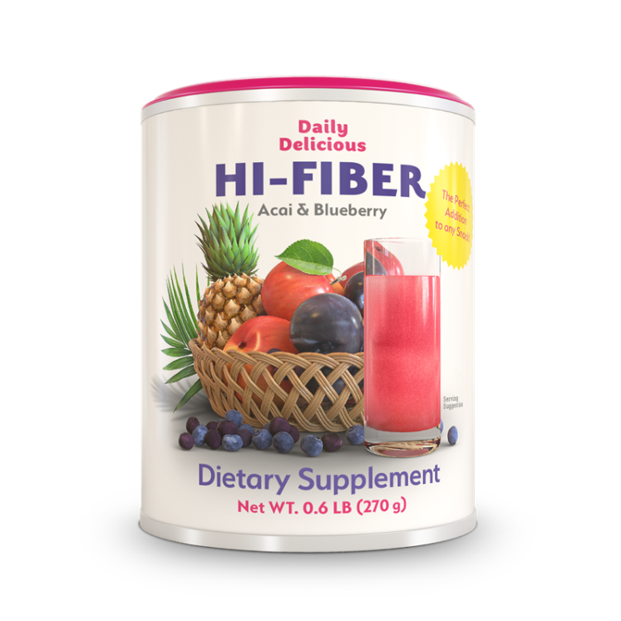
Daily Delicious
Hi-Fiber
A balanced source of dietary fiber with a pronounced berry flavor
CORAL-CLUB.COM

Slide 2
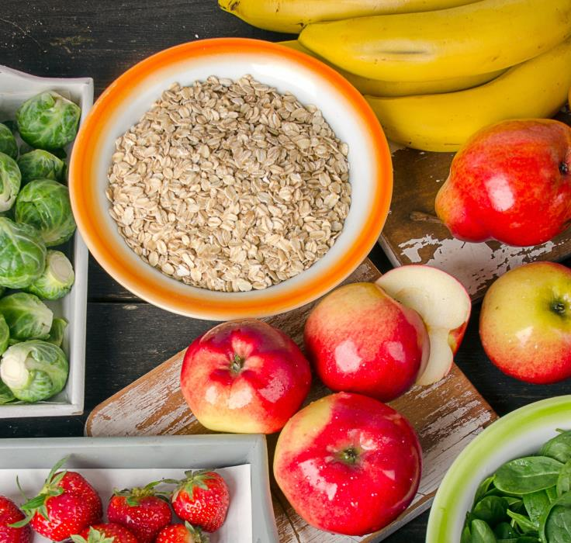
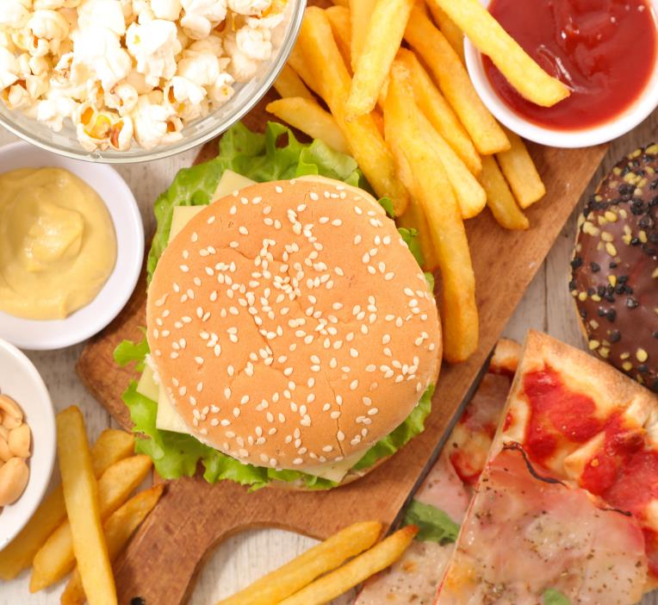
HEALTHY OR TASTY?

Slide 3

Many people eat junk food these days.
A diet composed mainly of junk food lacks many essential nutrients and fiber.
Notes:
Fiber is a substance found in plants. Dietary fiber is found in fruits, vegetables, grains etc. Eating fiber is an important part of a healthy diet plan*.
Fiber is a non-digestible carbohydrate. However, fiber plays an essential role in your digestive, heart, and skin health, and may improve blood sugar control, weight management, and more.*
Getting enough fiber is important for overall health and disease prevention. And it keeps your plumbing in good working order.
Fibers are components of plant foods, fruits, vegetables, dried beans and peas, lentils, nuts, and seeds — any food that is classified as a plant.
Insoluble fiber cannot dissolve in water and is made up from substances that offer rigidity to plant material, but soluble fiber can dissolve in water which allows it to form a gel. Most plant-based foods, even seaweed contain both types in varying amounts.
*http://www.heart.org/HEARTORG/HealthyLiving/HealthyEating/HealthyDietGoals/Whole-Grains-and-Fiber_UCM_303249_Article.jsp#.WZ75zVV95hE

Slide 4

Processed Foods
Mood swings
Overeating
Fiber, vitamin and mineral deficiency
High cholesterol
High blood sugar
Toxic build-up
Bowel movement and digestion problems
Weight gain
Notes:
Consuming food, deficient in fiber, can give rise to many problems, which could have been avoided.
Generally, processed foods are mostly “empty calories" without nutrients.
Eating processed foods can lead to people eating more than the recommended amounts of sugar, salt and fat as they may not be aware of how much has been added to the food they are buying and eating.
Manufacturers in the food industry use all these food additives to make their food delicious (but not healthy!). Processed food is literally engineered to be addictive. Compared to processed foods, natural food can seem tasteless.
That is one reason why people overeat.
We often eat processed and refined foods and much less fresh vegetables and fruits, because it’s easy to get fooled by packaged foods that sound more nutritious than they actually are.
The result is predictable and obvious – deficiency of vitamins, minerals and nutrients which can lead to an increase in weight, higher levels of cholesterol, digestion problems, problems with metabolism and toxic build-up.

Slide 5

Even if you are not a big fan of fast food, it is still likely that you don’t get enough fiber in your diet.
Why?
There are several reasons.
Notes:
You are not addicted to fast food? For a life of health and wellness, it is simply not enough to eat a healthy diet.
There still can be a lack of dietary fiber in your body!
Let’s look at the reasons.

Slide 6

You need: 7-8 portions
We eat too few fruits and veggies which can result in nutrient deficiencies.
We peel veggies and fruits.
Notes:
1. According to Canada’s Food Guide, 7-8 servings of fruits and veggies a day is recommended for adults*. On average, we eat only one serving of fruits and vegetables a day; some people do not eat fruits and vegetables at all.
2. At different times of the year, fresh produce may not always be available.
3. Some people prefer to peel fruits and vegetables: some are confused by the fact that the peel contains harmful substances, others don’t like its harsh rind. Meanwhile, it contains fiber needed for normal digestion.
4. Cereals and grains are a good source of dietary fiber**. Some people, who have no time to cook, prefer to eat instant cereals. But usually, “instant” means that this product went through industrial processing where beneficial properties and dietary fiber of the product were lost.
5. Nuts (walnuts, peanuts, almonds, cashews, pistachios) contain a large amount of dietary fiber, though they are very caloric**. Same with dried fruits which contain not just fiber and vitamins, but also sugar. It is easy to overeat dried fruits due to the fact that they are sweet.
*https://www.canada.ca/en/health-canada/services/food-nutrition/canada-food-guide/choosing-foods/vegetables-fruit/many-food-guide-servings-fruits-vegetables-need-canada-food-guide.html
**https://www.accessdata.fda.gov/scripts/InteractiveNutritionFactsLabel/dietary-fiber.html

Slide 7

Some diets exclude fruits
Notes:
Some diets can lead to fiber deficiency.
For instance, fans of high protein diets (Ducan and Atkins diets, as examples) don’t eat fruits at all, but they eat a lot of fish and meat which have no fiber. The concern with eating meat all the time is that it may leave you with a heavy stomach, and irregular bowel movement, which leads to undigested food in the body.
This type of diet can lead to headaches and fatigue, skin problems and constipation.

Slide 8

Seniors don’t eat enough fruits and vegetables because of common dental problems.
Notes:
Some seniors find it difficult to chew fruits and vegetables because of dental problems, so it can lead to a fiber deficiency in the body.
As the body ages, changes in the gastrointestinal tract occur, that reduces the absorption of nutrients and slows down intestinal motility. Malabsorption, nutrient deficiency and constipation are relatively common health problems that affect elderly people of both genders.
Even people who did not experience any digestive problems in their youth, find it necessary to turn to supplements like probiotics and laxatives in old age.

Slide 9



Fiber is good for intestinal microflora.
Healthy intestinal activity is an important part of a strong immune system and proper metabolism, which leads to good health, vivacity, youth and beauty.
Notes:
Fiber is an essential part of your daily diet.
Fiber is very important to intestinal flora, it stimulates gastric motor activity, provides elimination of toxins and bad cholesterol, helps to control blood sugar and weight.

Slide 10

Fiber is health!
Notes:
Your diet may be lacking an important nutrient for your health: dietary fiber (daily value – 25 g per day). The goal is to get 100% of the Daily Value for dietary fiber on most days.*
According to a 8 year study conducted in 1991, cereal fiber intake was found to be related to a decrease in the risk of type 2 diabetes in younger and middle-aged women.**
According to a study published in the British Medical Journal, “A high intake of dietary fibre, in particular cereal fibre and whole grains, was associated with a reduced risk of colorectal cancer.” ***
*https://www.accessdata.fda.gov/scripts/InteractiveNutritionFactsLabel/factsheets/Dietary_Fiber.pdf
**https://www.ncbi.nlm.nih.gov/pubmed/15277155
***http://www.bmj.com/content/bmj/343/bmj.d6617.full.pdf

Slide 11

Fiber is
beauty!
Notes:
Fiber also plays a vital role in improving the effectiveness of the gastrointestinal system, it helps to remove heavy metals, toxins and slags because their buildup in the body can lead to various health problems.
Toxins and slags lead to metabolic disturbances in the body, which mainly affect our skin.
Any “beauty diet” is based on eating products high in fiber. Moreover, foods rich in fiber contain vitamins and amino acids, which contribute to beautiful skin, firm nails and shiny hair.

Slide 12

Fiber is a neat figure!
Notes:
Scientists from Europe, USA and Canada have known that a fiber-rich diet is useful for maintaining weight.
Fiber-rich foods not only fill you up faster and keep you satisfied longer, they also prevent your body from absorbing some of the calories in the foods you eat. That’s why regular intake of fiber will help to maintain you body weight and improve your body health.
It is also very important to drink enough water!
There is no doubt that fiber is a vital part of proper nutrition.

Slide 13

Daily Delicious Hi-Fiber is a balanced source of dietary fiber with a pronounced berry flavor.
Fiber that tastes great!
1 can = 30 servings (9 g each),
1 serving per day.

Slide 14


Hi-Fiber is a balanced combination of different fiber types and other useful components for the digestive system.
Soluble fiber
Insoluble fiber
Glutamine
Aloe Vera gel
Natural berry flavoring, stevioside
=
Notes:
Hi-Fiber is a balanced combination of different fiber types and active components that supply our body with enzymes, amino acids, vitamins and minerals.
Product uniqueness: it contains Aloe Vera gel and Glutamine, which are effective in restoring and normalizing intestinal functions.

Slide 15
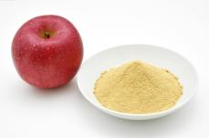
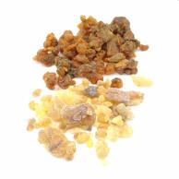
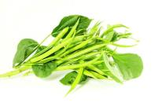
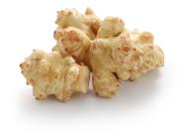
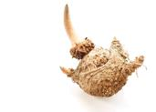
Protects the mucous membrane of the stomach and intestines*
Facilitates the removal of toxins and slags from the body*
Gives a feeling of fullness that helps to prevent overeating and gaining extra weight.*
Soluble fiber
Apple fiber and Pectin
Guar gum
Gum arabic
Inulin
Glucomannan
HI-FIBER INGREDIENT – SOLUBLE FIBER:
Apple fiber and pectin, guar gum, gum arabic, inulin, l-glucomannan
Notes:
Soluble fiber forms a jelly-like mass that absorbs a large amount of water, protects the mucous membrane of the stomach and intestines, facilitates the removal of toxins and slags from the body. Moreover, it gives you a feeling of fullness that helps to prevent overeating and gaining extra weight.
*https://www.accessdata.fda.gov/scripts/InteractiveNutritionFactsLabel/dietary-fiber.html

Slide 16
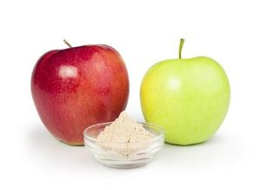
Apple fiber and pectin
Helps to maintain a healthy weight*
Helps to normalize the level of cholesterol*
Improves intestinal microflora*
Has a positive influence on the metabolism*
Notes:
Apple fiber gives the feeling of fullness, reduces the appetite and helps with metabolism. It helps to reduce the level of bad cholesterol and improves intestinal microflora and intestine functioning as a whole.
Apple fiber has a positive influence on the metabolism, cholesterol levels in the body and helps with peripheral circulation and gut motility. Pectin helps to detox heavy metals and food additives from your body.

Slide 17
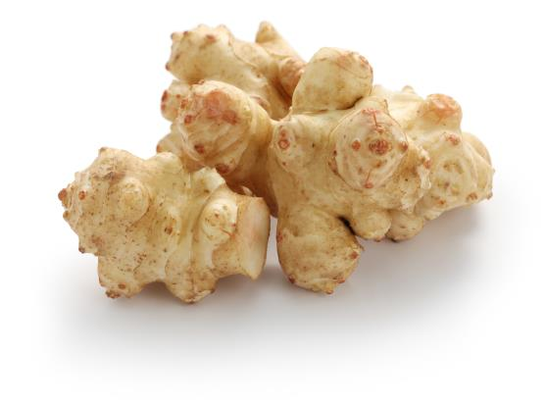
Stimulates the growth of beneficial intestinal bacteria, promotes digestive health*
Inulin
Notes:
Inulin is naturally present in many different foods. Higher concentrations exist in herbs. Inulin from chicory root is used in Hi-Fiber.
Inulin – is a nutrient for intestinal microflora.
It has a beneficial role in gastric health*, helps to control blood sugar, promotes weight loss.
Inulin helps to cleanse the body of toxins and slags and has a beneficial effect on the liver.
*https://www.ncbi.nlm.nih.gov/pubmed/27178951

Slide 18

Fat adsorption from the small intestine*
Appetite suppression*
Control of blood sugar*
Glucomannan
Notes:
Glucomannan is a sugar made from the root of the konjac plant that has been used for centuries in traditional Japanese cooking as a thickener or gelling agent.
An 8 week double-blind study showed a mean weight loss as well as a reduction in serum cholesterol and low density lipoprotein cholesterol in obese patients.*
It takes up space in the stomach and promotes the feeling of fullness (satiation), reducing food intake. Moreover, it helps to control blood sugar.
Because of its incredible ability to expand exponentially and its ability to absorb a large amount of liquid, it is important to drink enough water when consuming hi-Fiber.
*https://www.ncbi.nlm.nih.gov/pubmed/6096282

Slide 19
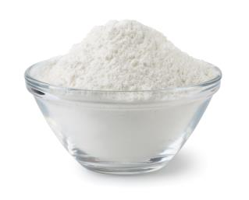
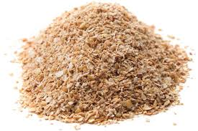
Provides “bulk” for stool formation*
Speeds up the movement of food and waste through the digestive system*
Promotes better nutrition*
Insoluble fiber
Cellulose
Rice bran
HI-FIBER INGREDIENT – INSOLUBLE FIBER:
Cellulose and Rice bran
Notes:
Insoluble fiber* (cellulose, rice bran) activates laxation, accelerates digestion, improves metabolism and provides assimilation of vitamins, minerals and other nutrients.
In Hi-Fiber, cellulose and rice bran are sources of insoluble fiber.
Rice bran (byproduct of the rice milling process) “scrubs” the intestinal walls to get rid of waste. Rice bran is a rich source of vitamins, minerals, essential fatty acids and dietary fiber.
Bran adsorbs toxins and cholesterol, improves digestion and cleanses the stomach and intestines, which leads to a healthy microflora in the body.
Cellulose absorbs water, facilitating the work of the colon. Cellulose benefits include helping food move through your digestive system more quickly, thus preventing constipation.
*https://www.accessdata.fda.gov/scripts/InteractiveNutritionFactsLabel/dietary-fiber.html

Slide 20
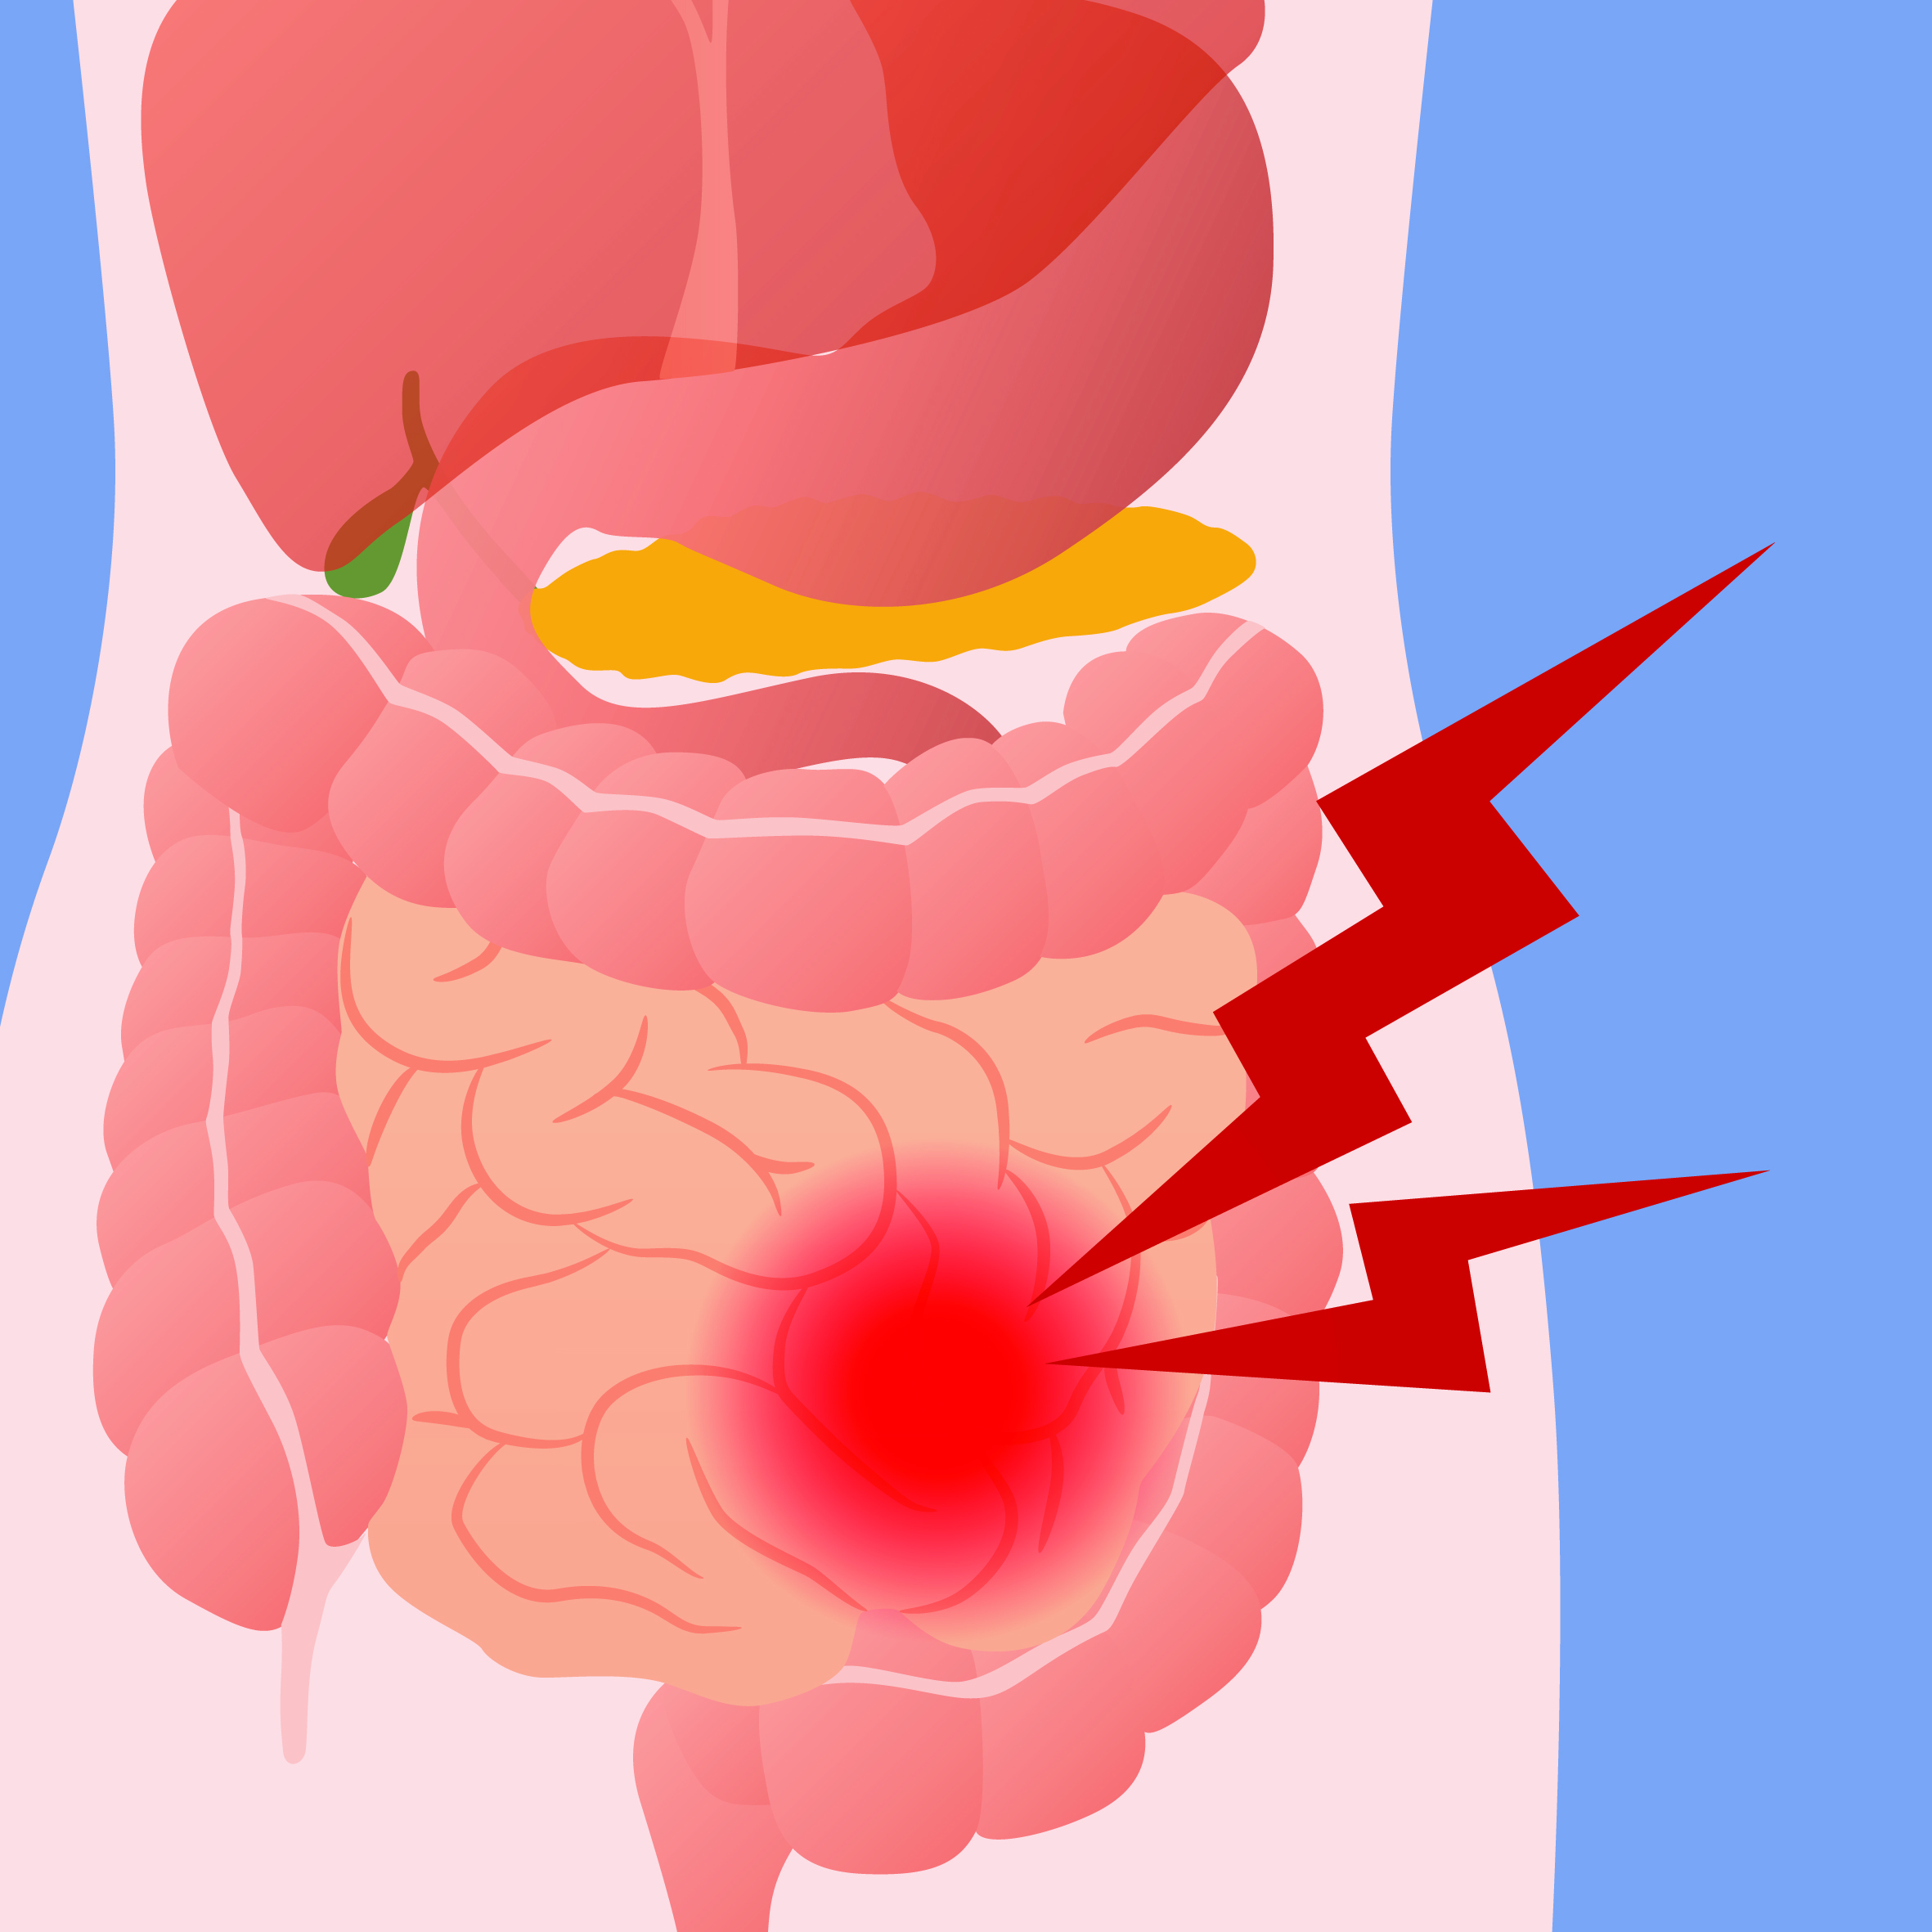
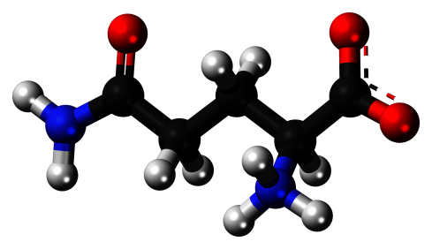
Glutamine
Protects the mucosa in the digestive tract*
Hi-FIBER INGREDIENT - GLUTAMINE
Helps with “irritable bowel syndrome”*
Notes:
Glutamine - is a conditionally essential amino acid, which provides protein production and is necessary for sustaining bowel action, especially when the mucous membrane is damaged (irritable bowel syndrome).
The most common symptoms of IBS are:
abdominal (stomach) pain and cramping,
bloating and swelling of stomach,
a change in your bowel habits.

Slide 21
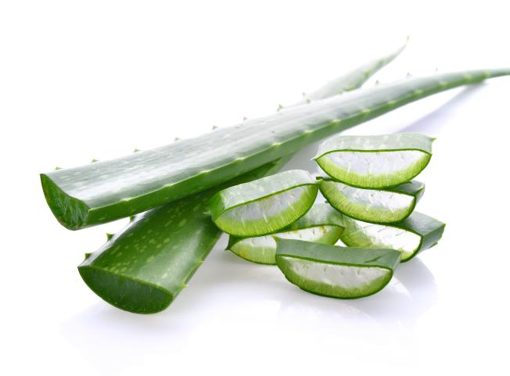
Protects the stomach from irritation*
Improves intestinal motility and promotes the growth of useful intestinal microflora*
Serves to normalize digestive tract function, and also to fortify the immune system*
Cleanse the body from toxins, helps with bowel movement*
Aloe Vera Gel
UNIQUE NATURAL BIOSTIMULANT
HI-FIBER UNIQUE BENEFIT:
ALOE VERA GEL AS HI-FIBER INGREDIENT
Notes:
Aloe Vera is well known for its succulent leaves and the many uses of the gel obtained from them.
It activates the work of the immune system, helps with inflammation.
Anthraquinones in Aloe Vera have are known to have a laxative effect and also antibacterial and antiviral properties.
Aloe Vera Gel helps to protect the gastrointestinal mucosa from irritation.

Slide 22
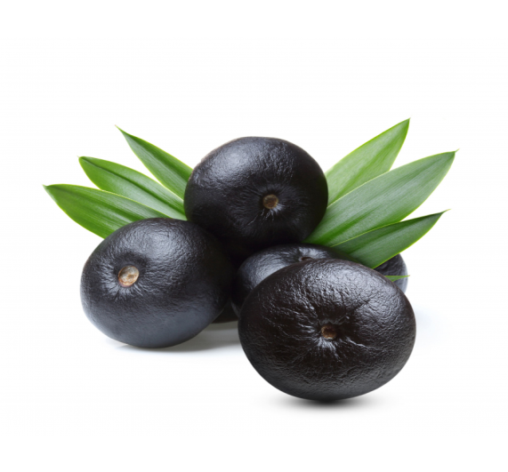
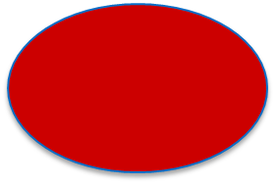
Acai Berries
Slow down the aging process due to high level of antioxidants which remove free radicals*
Improve Cardiovascular Health*
Help in weight loss and skin care*
Popular Antioxidant
NATURAL BERRY FLAVOR AND DELIGHT:
ACAI BERRY EXTRACT AS HI-FIBER INGREDIENT
Notes:
One of the most important qualities of acai berries is its ability to slow down the aging process, due to its high levels of antioxidants. This berries improve cardiovascular health by relaxing blood vessels and generally serve to normalize blood circulation.
Acai berries are one of the newest and most popular organic solutions for a wide range of health concerns.

Slide 23
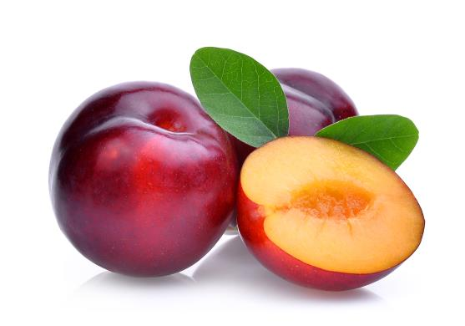
Rich in food fiber (pectin)
Contain potassium, phosphorus, magnesium, iron, vitamins and organic acids
Help with laxation and digestion*
Help to reduce cholesterol and blood sugar levels*
Plums
SOURCE OF PECTIN AND OTHER USEFUL NUTRIENTS
PLUM FRUIT POWDER
Notes:
Plums contain an assortment of healthy components such as potassium and phosphorous; also calcium, magnesium and iron.
Plums contain pectin, tannins, nitrogenous matter and organic acids (citric acid, malic acid and oxalic acid)
Plums are known to be effective natural laxatives and can help to maintain regular bowel habits. Plums also have detoxifying effects in the body. Fiber in plums helps to lower the cholesterol levels. Pectin from plums helps to cleanse and detox your body.

Slide 24

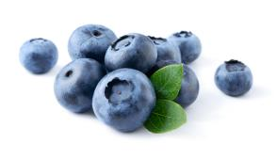
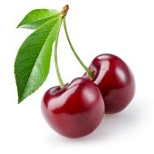
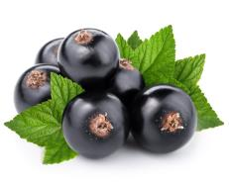
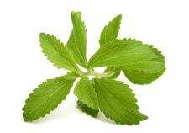
Natural flavoring
NATURAL BERRY FLAVOR AND DELIGHT :
BLUEBERRY, CHERRY, CURRANT, STEVIOSIDE
Notes:
Natural berry flavors and stevia extract sweetener are used in Hi-Fiber

Slide 25

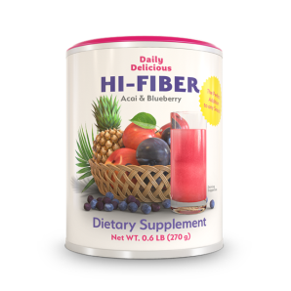
Has a delightful natural flavor*
Berry flavor + stevioside sweetener
Improves digestion*
That means improves health in general
Protects the stomach and intestines from irritation* Aloe Vera Gel and Glutamine amino acid
Easy to prepare
You need just a glass of water
Helps to keep a healthy weight*
It gives you a feeling of fullness
KEY BENEFITS
Notes:
*These statement have not been evaluated by the Food and Drug Administration. The product is not intended to diagnose, treat, cure or prevent any disease.

Slide 26
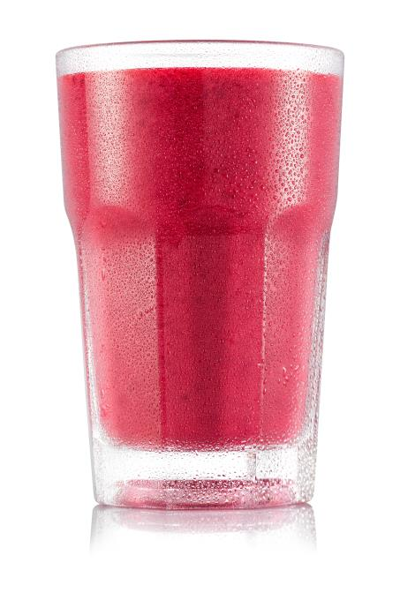
= just 25 calories!
Notes:
1 serving of Hi-Fiber contains just 25 calories.

Slide 27

Eubiotic dinner*
(1 hour before sleep)
Milk or other dairy products
1 serving of Hi-Fiber
Notes:
Hi-Fiber is an addition to the Coral Detox program or as a part of an eubiotic dinner.
Consuming any dairy product, adding 1 serving of Hi-Fiber, 1 hour before sleep promotes lacto and bifidobacteria growth.
http://www.intjnm.org/old_site_structure/admin/article/Bruce_Kao,_Shimon_Levytam.pdf

Slide 28
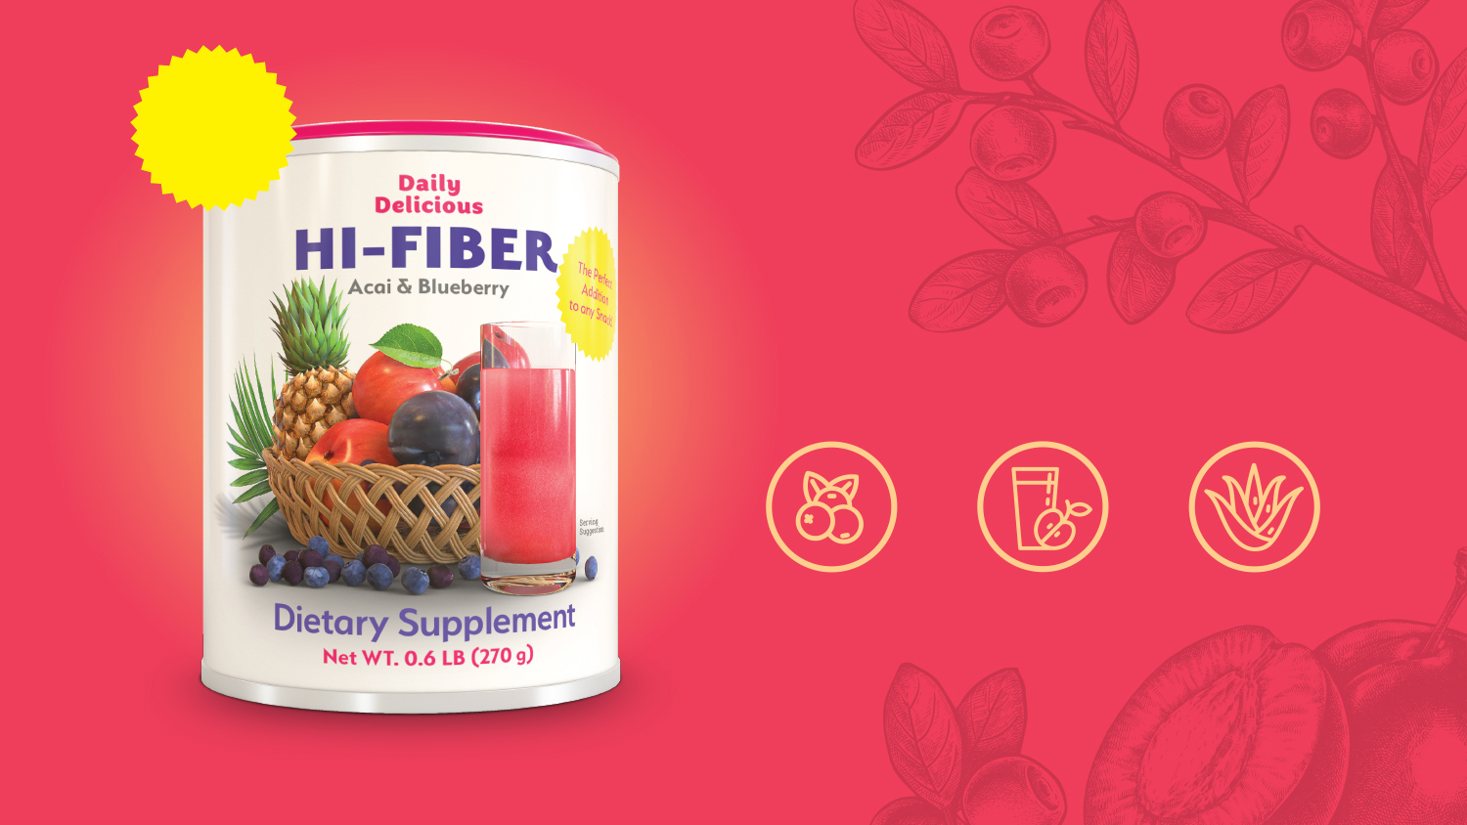
The perfect addition to any snack
Hi-Fiber
Delicious dietary fiber
Natural berry flavor
Good source of fiber
Aloe Vera and
L-glutamine

